Slide 1
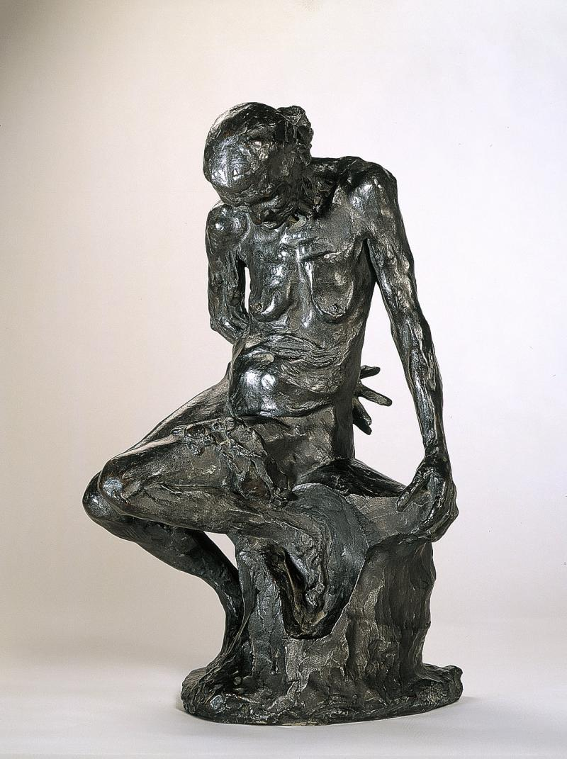
The Helmet Marker’s Wife (1887)
Auguste Rodin

Slide 2
‘Les Regrets de la Belle Heaulmière’ by François Villon
Rodin based this work on Villon’s poem, which describes an old woman battling with how age has ravaged her and taken away her beauty.
Descriptions within the poem such as ‘Poor desiccated thin, shrivelled,’ ‘This is the fate of human beauty!/ Shrunken arms and clenched hands/ And completely hunchbacked.’ and ‘What breasts! All wizened/ Like my hips’ clearly influenced Rodin’s modelling of the figure.

Slide 3
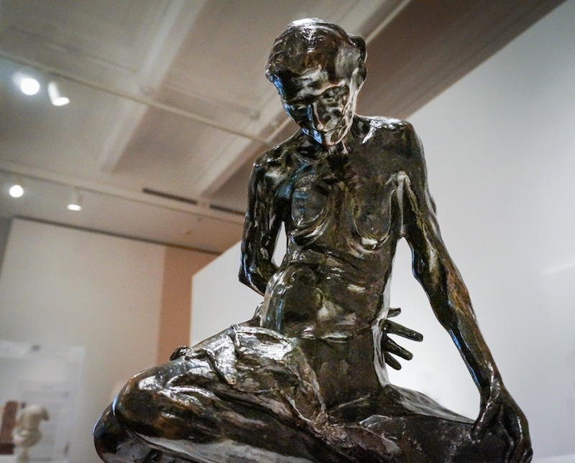
Who modelled for this work?
She was a mother of one of Rodin’s male models.
Her name was Caira.
She had come to Rodin’s studio to see her son one last time before she died, apparently making the journey from Italy by foot.
Why did Rodin use her for his work?
Rodin was taken by her ageing skin which hung from an elegant bone structure.
He was fascinated by the inevitable decline of the human body, perceiving the physical changes not as ugliness but rather as adding character and personality.

Slide 4
Characteristics -
Gaze – looks downt to breasts and stomach which creates a focus on these areas.
pose – crippled and hunched to accentuate age – hand reaches around back creating negative space.
colour – dark, opposing tradition.
material – bronze
Accentuates wrinkles (makes them more obvious) due to reflection of light on polished surface.
Plinth – a rock which is similar in texture to her skin which creates a link between them, they are both old.
Size – 50cm
(small scale)

Slide 5
More info …
How is Bronze used?
The polished finish accentuates wrinkles which could only be done through a bronze cast to get these textures.
Negative space used in pose along with fingers which can be modelled in bronze due to tensile strength.
The colouring opposes traditional marble and fair skin.
Female Nude – Breaking tradition
An old woman is modelled
Her skin is wrinkled and not white, which would have been done with marble.
She faces away from the audience but not in a passive way
Not carved in marble which it would have been traditionally.
Her skin is sagging, focus is on stomach and breasts but not in a provocative way – nothing to do with the male gaze.

Slide 6
Avant Garde and Aims
Avant Garde as it opposes traditional female nude depictions for reason already listed.
Rodin’s Aims :
To depict a female in the untraditional way, rejecting idealisation but celebrating the beauty of aging – although she is old you can see the life she lived through her wrinkles.

Slide 7
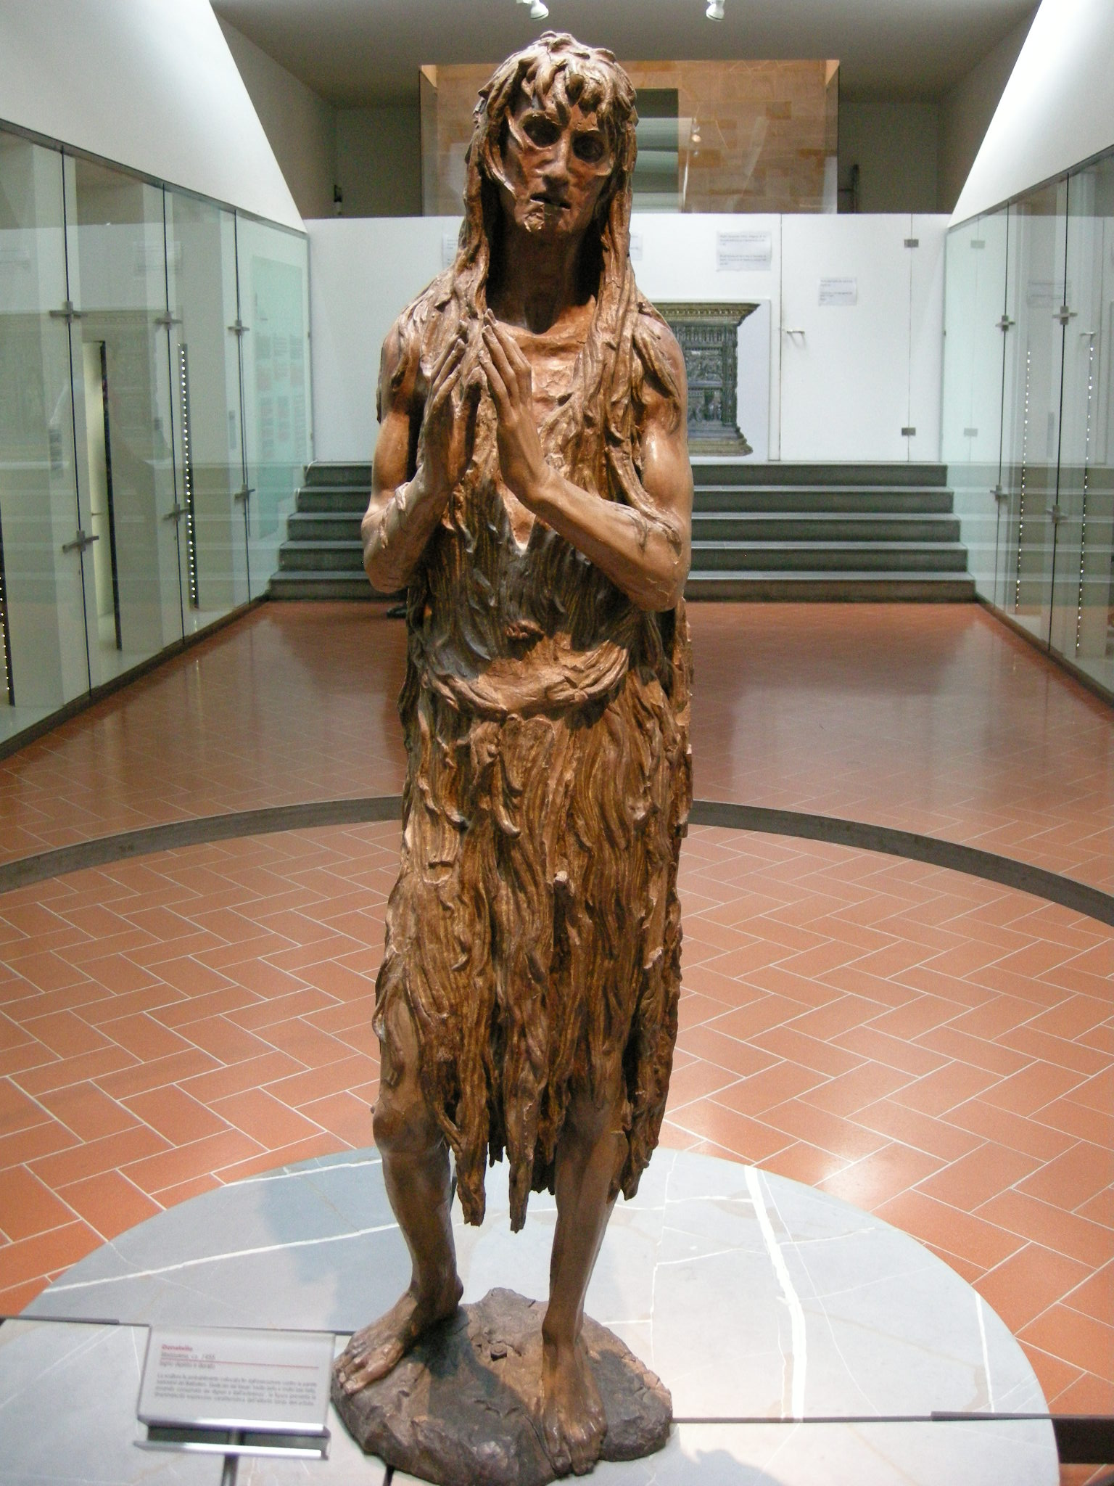
Influences
Rodin travelled to Italy in 1875 and saw artists like Donatello.
Rodin commented, ‘In art, only that which has character is beautiful. Character is the essential truth of any natural object.’
How has Robin been inspired by the sculpture:
Both are interested in the process of aging – evident in the prominent skeletal features, especially seen in the face of the figure (Donatello)
Focus on Realism
Highlights form as a symbol of maturity
Donatello ‘Penitent Magdalene (1455)

