Slide 1
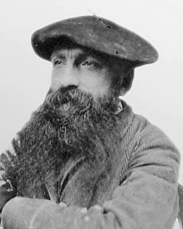
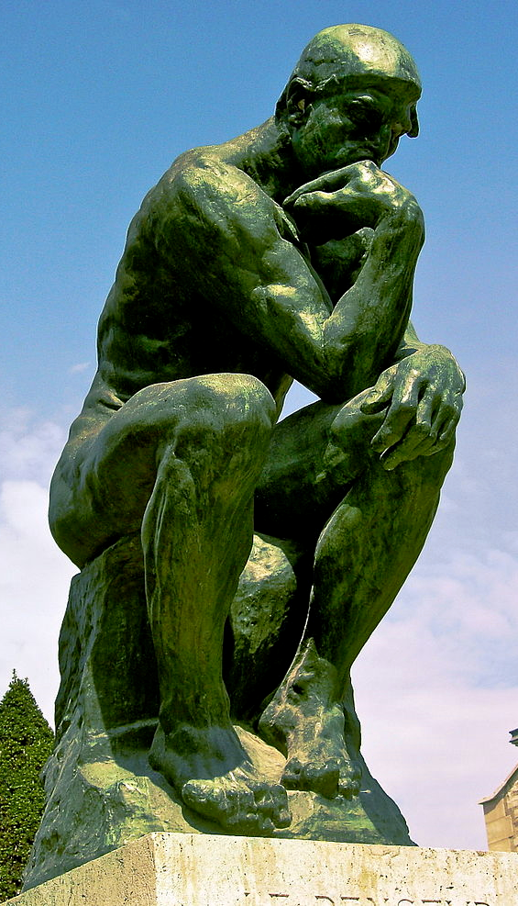
Auguste rodin Biography

Slide 2
Biographical details:
A French sculptor born in Paris 12 Nov 1840 - 17 Nov 1917.
Rodin began to draw at age 10, despite his poor vision
Went on to study art and maths at the petit Ecole at the ages 14-17 where he found a love for drawing
Rodin however didn’t become established until his late 40s with his controversial sculptures
Rodin’s most original works was of traditional themes like mythology and allegories
He focused on the human figure and forms with realism.
How was he avant-garde?:
However in the 1890s Rodin transformed his sculptures making the Avant-garde and modern
His sculptures told stories of internal and conceptual meaning where there was no right or wrong way to interpreted them
He focused on manipulating his contours and surfaces of the bronze to help convey emotional content.
His work is the crucial link between traditional and modern art.

Slide 3
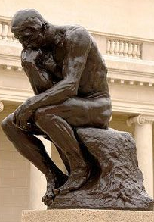
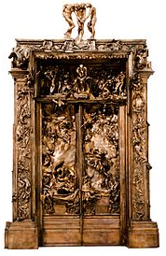
3 major Commissions:
The Gates of Hell: 1899
Commissioned in 1880 for the Museum of Decorative Arts, Paris but the museum was never built
Inspired by Dante’s Inferno and Michelangelo's ‘Last Judgement’
Exhibited 1900, cast in bronze 1925 (8 years after his death)
Wasn’t satisfied with them
The Thinker: 1880 (bronze cast 1902)
Is the figure on top of the ‘Gates of Hell’ piece, represents Dante / someone gazing at the hellish scenes below him
Over 50 casts have been made and scattered all over the world
Chose one for his tombstone
Balzac: 1898
Received the commission to memorialize the French novelist and poet
Like many of his works he did extensive research and took a long time
The Cociete des Gens de Lettres rejected it and only in 1930 were2 bronze copies made

Slide 4
Italy 1875:
His first major figure was inspired by his trip to Italy in 1875
He visited here for 2 months due to being drawn to the work of Donatello and Michelangelo which, in turn, had a large impact on his artistic direction
“it is Michelangelo who has freed me from academic sculpture” – Rodin
He returned to Belgium in 1876 and completed ‘The Age Of Bronze’ before moving back to Paris the following year

Slide 5
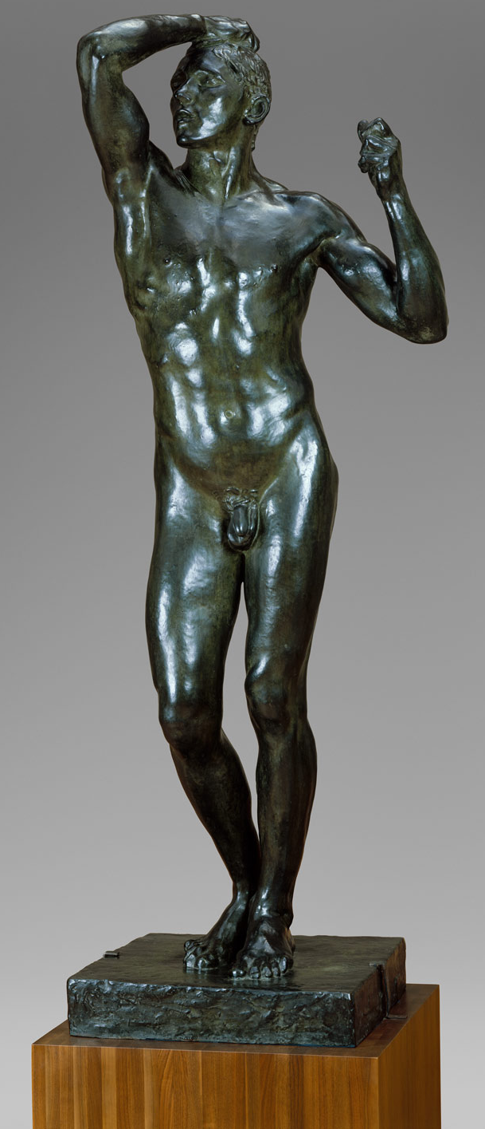
Age of bronze scandal:
The sculpture
‘The Age of Bronze’ (1877) is a sculpture made of bronze and sculpted by Rodin
It was also known as ‘The Awakening Man’ or ‘The Vanquished One’.
The sculpture was modelled after Auguste Ney, a Belgian soldier. Rodin depicted a man in the early stages of mankind, and suggests heroism and suffering which reflects what people went through during the Franco-Prussian war (1870-1871).
It became one of Rodin's best examples of realism.
The scandal
Rodin was accused of using life cast of his sitter to create the sculpture, rather than sculpting it himself, due to his use of realism and extreme naturalism.
He had to disproved these accusations by using thorough study profiles of his model.
This scandal led many people to visit the sculpture to see and decide for themselves.

Slide 6
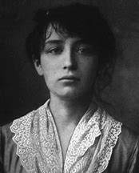
Camille Claudel:
In 1892, following an abortion, she ended the intimate aspect of her relationship with Rodin, though they continued to see one another until 1898.
Vauxcelles stated that “she was the only sculptress on whose forehead shone the sign of genius”.
Because of gender bias and the sexual element of her sculptures, she could not get the funding to have her daring ideas realised.
Therefore, she4 depended upon Rodin to both realise her artistic ideas and support her financially.
Works:
Rodin’s ‘Galatea’ (1889) almost perfectly mirrors Claudel’s ‘Young Girl with a Sheaf’ (made 2 years earlier in 1887).
Rodin’s ‘Mask of Camille’ was exhibited in 1900.
While working in Rodin’s studio, she was entrusted with difficult pieces such as the hands and feet of figures.
She was the co-worker and lover of Rodin.
In 1982 Rodin felt passionately about her though she wanted some distance between them. When she returned from England, he promised that she be would be his only pupil and he swore to be faithful to her.
She started working in Rodin’s workshop around 1884.
She became a source of inspiration for him, acting as his model and someone he could confide in.
Rodin was reluctant to end his 20-year relationship with Rose Beuret in the early days of his affair with Claudel.
Claudel’s mother was agitated by the affair. Her mother also detested her for not being a boy and did not support her involvement in the arts.
Claudel left the family home.

Slide 7
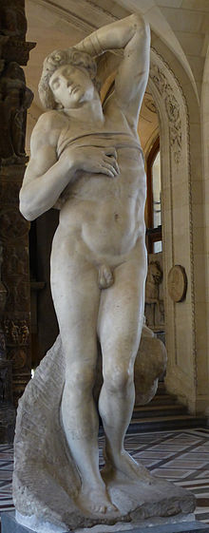
His inspiration:
He was inspired by sculpture from the classical era
Especially the works of Michelangelo and Donatello
Was also inspired by the work of Dante (writer/poet)
When commissioned to do a piece he would usually do extensive research into the person and use that as inspiration for the final piece

Slide 8
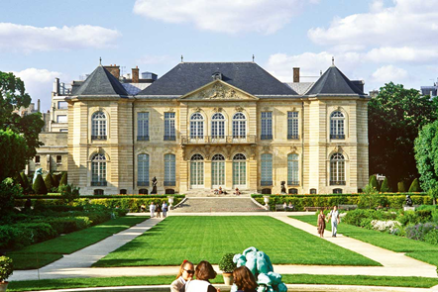
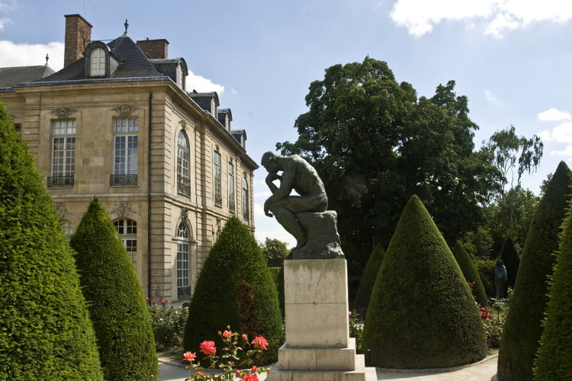
His legacy:
Henri Matisse was inspired by the spontaneity of his drawings
Cubists and Futurists were fascinated by his sense of motion and fragmentation of his human forms
Due to his financial success, several exhibitions around the century made him renowned worldwide
He was given his first retrospective in Paris 1900
Before his death he took back all of his drawings and sculptures to create a museum in the Hotel Biron at Meudon
His rebellion against Academic art lived on to inspire others

