Slide 1
The Burghers of Calais
By Auguste Rodin
1884-89
Scale – 201.6cm x 205.4cm x 195.9cm
Material - Bronze
Patron – Calais (government)

Slide 2
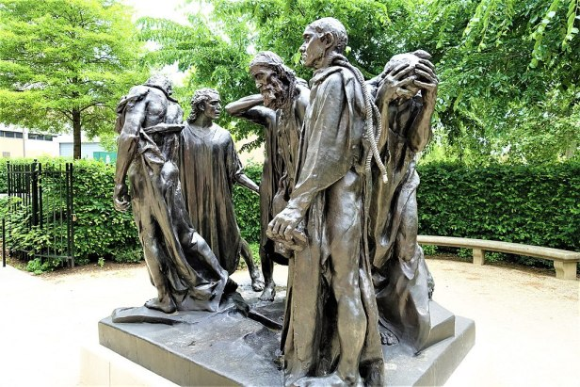
The event it commemorates
The sculpture is based on the Siege of Calais by English troops during the hundred years war in 1337. The King of England at the time: Edward III proposed that he would allow the citizens of Calais freedom under the conditions that the city surrender and that the 6 burghers/members of the city council sacrifice their life.
The sculpture depicts the 6 men gathered to leave their city and go to their deaths. Rodin depicts their grief in death whilst expressing their strength which would result in the freedom of the Calais people.

Slide 3
First to volunteer and surrender, wearing "a shirt and a rope around his neck“.
Saint Pierre (main figure) leads them
Anguish, shame: lack of a confrontational gaze. Draped in a large bit of fabric, rope dangles over his shoulder. Muscular: strong and brave both metaphorically and physically.
Pyramidal composition was a technique of arranging the figures in a pyramidal shape popular in High Renaissance paintings and sculptures. This was to give the work a sense of calmness and stability as well as a unity and bond between the figures. Rodin deliberately rejects this, instead choosing to display all the figures all on one level. This then places the figures the equals with no clear focus on a particular figure as a leader through the use of a circular composition. This allows the work to be walked around and seen from multiple perspectives.

Slide 4
How was the work intended to be displayed?
Comment on Rodin’s depiction of heroism, how does it differ to traditional depictions of heroism?
However, the raised pedestal did not allow an audience to view the work of art as Rodin had intended. Therefore, he created a second version, one lacking a pedestal, to be placed at the Musée Rodin at the Hôtel Biron in Paris. Rodin’s goal was to bring the audience into his sculpture of The Burghers of Calais, and he accomplished this by not only positioning each figure in a different stance with the men’s heads facing separate directions, but he lowered them down to street level so a viewer could easily walk around the sculpture and see each man and each facial expression and feel as if they were a part of the group, personally experiencing the tragic event.
Because the patrons wanted a heroic quality, with a raised pedestal that would place the figures in a God-like status high above the viewers, Rodin presented the city of Calais with The Burghers of Calais complete with a pedestal.
It was common in the nineteenth-century to depict an event with a single heroic figure. For example, Rodin’s later sculpture Monument to Balzac (1891-97), where the French playwright and novelist, Honoré de Balzac, is shown standing tall and alone with his head held high. This is similar to what the city of Calais was inevitably expecting from Rodin. As a result, they were displeased with Rodin’s concept—they wanted only one statue; the one of Eustache de Saint-Pierre. Instead, Rodin included all six men from Froissart’s account.

