Slide 1
The Helmet Maker’s Wife, 1887
Auguste Rodin

Slide 2
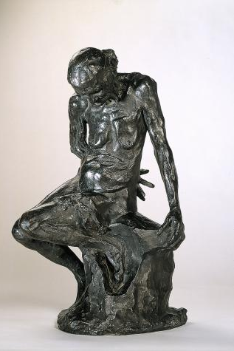
The meaning behind the work.
The title is based on a poem by Francois Villon. The poem is about a Helmet Maker’s once beautiful wife.
She kept looking at herself in the mirror and watched her body gradually age over time, and began to miss what she used to be.
The themes of the poem include consequences of ageing and standards of beauty.
This quote reflects the themes particularly:
“What I was, what I am today,
View myself naked: turn at bay,
Seeing what I am no longer,
Poor, dry, meagre, worn away,
I almost forget myself in anger”

Slide 3
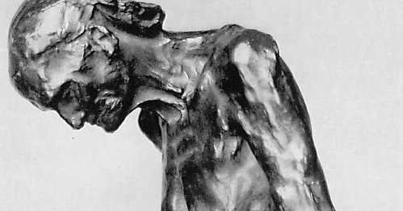
Who modelled for this work?
An 82 year old woman called Caira had travelled from Italy to Paris on foot, to see her son model for Rodin before she died.
Rodin was fascinated by her inevitable decline of her human body and asked her to model for him.
For him her ageing body added character and he was captivated at her physical change, he said that “in art only that which has character is beautiful”

Slide 4
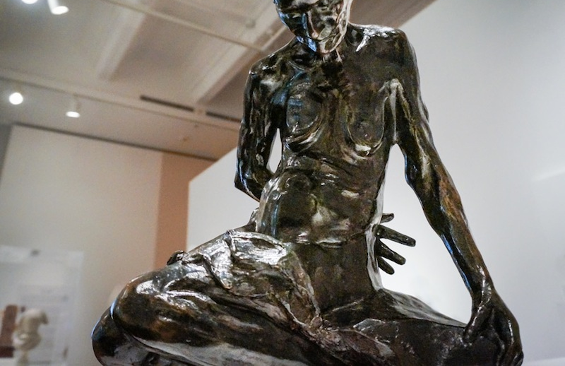
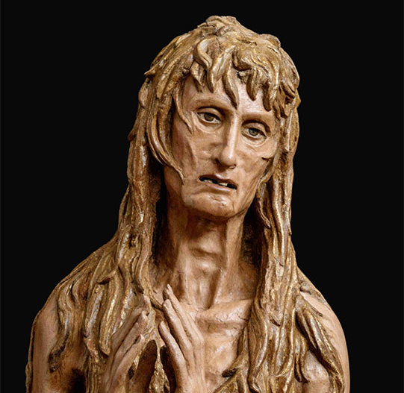
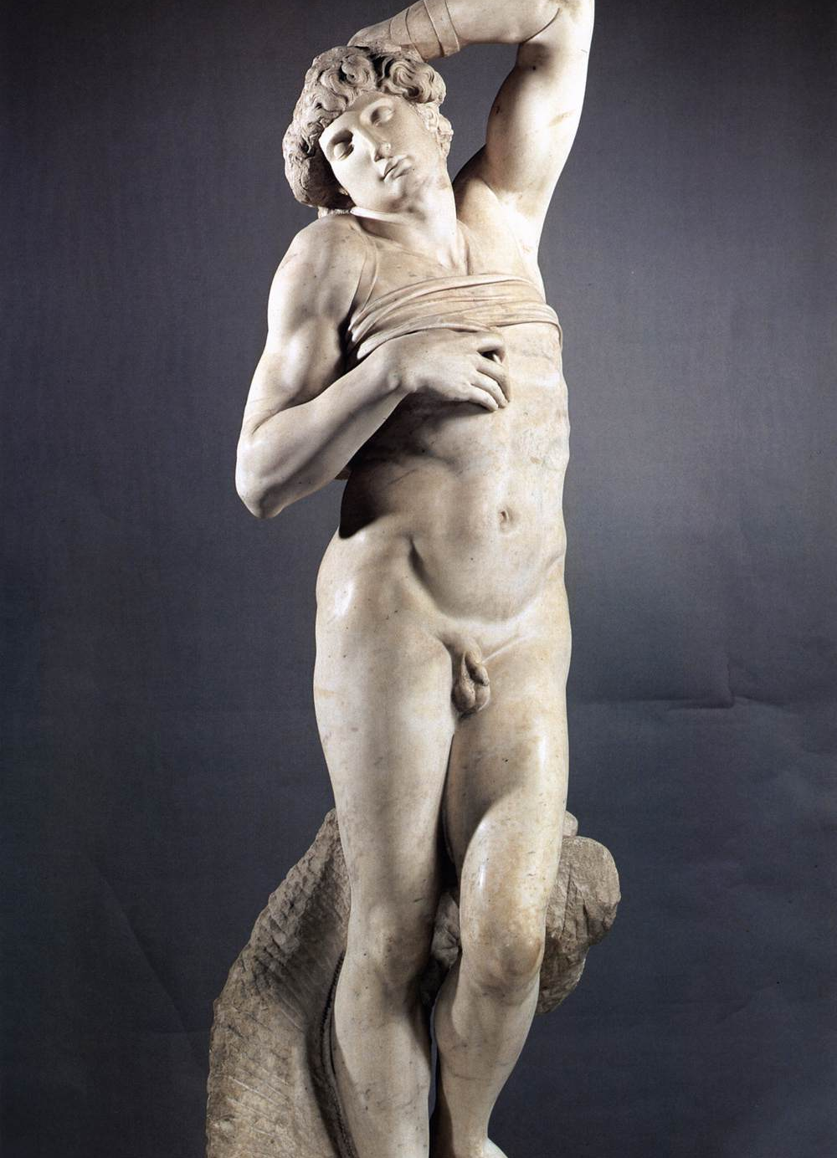
Rodin’s Inspiration
Rodin took inspiration from Donatello’s ‘Penitent Magdalene’ specifically on the texture on her hair and applied it to Caira’s wrinkles- accentuating her ageing skin.
Both women are unidealised and realistic as he uses a rough, textural sense in certain areas.
He was also inspired by Michelangelo's ‘dying slave’- especially Michelangelo’s depiction of the human form.

Slide 5
Rodin’s visits to Italy
In 1876 Rodin made several visits to Italy initially to discover the works of his masters Donatello and Michelangelo -then to nurture and revive his relationship with them.
His departure from the academic style can be seen in his work as he abandoned any sense of idealism and strived to depict the internal mood of a figure, and its impact on their form.
So in this case he depicted Caira’s deteriorating body as a means to express melancholia and her soon to be death.

Slide 6
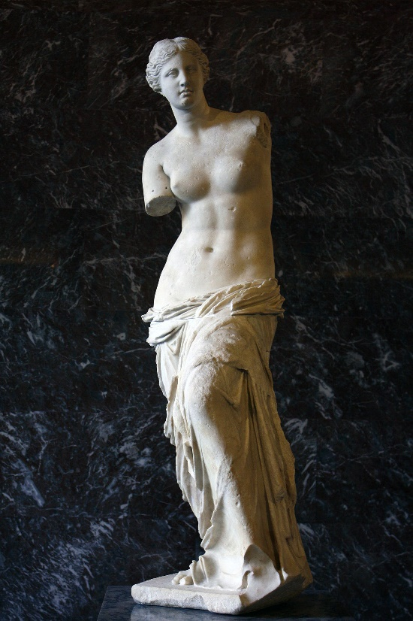
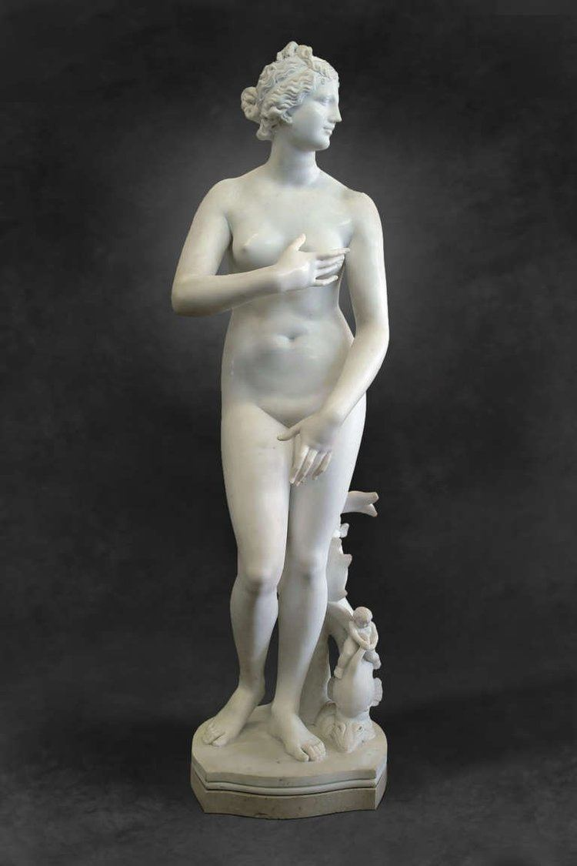
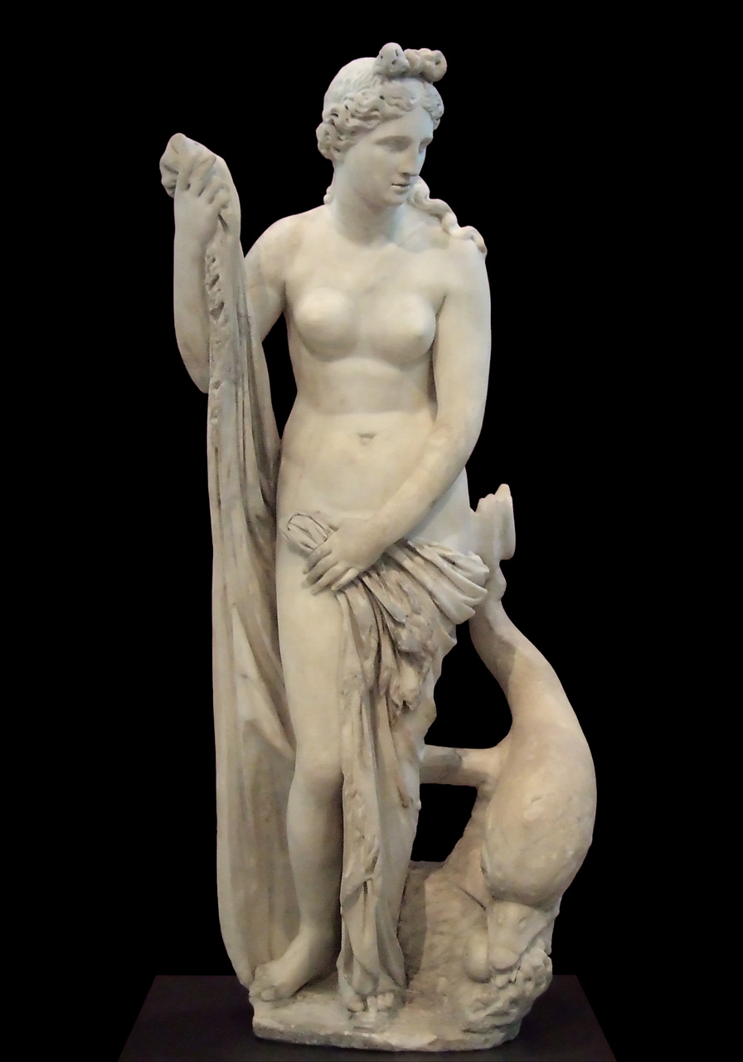
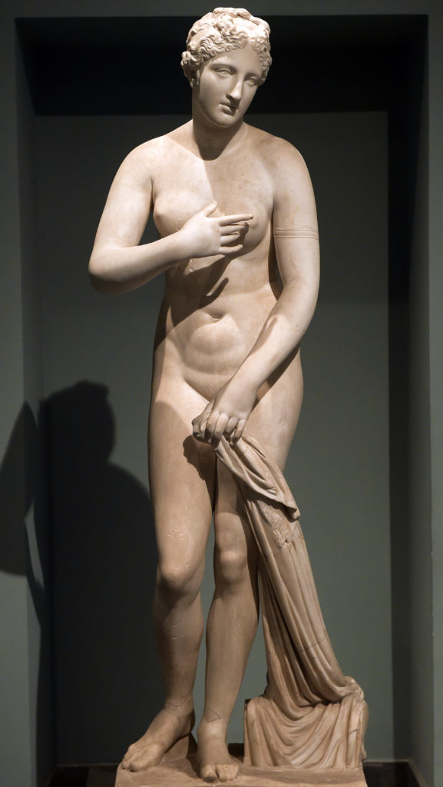
How it breaks the conventions of female nude in sculpture & Rodin’s Agenda:
Previously, the female nude in sculpture had deities as subject matter. Examples of this are the timeless use of Venus and Aphrodite.

Slide 7
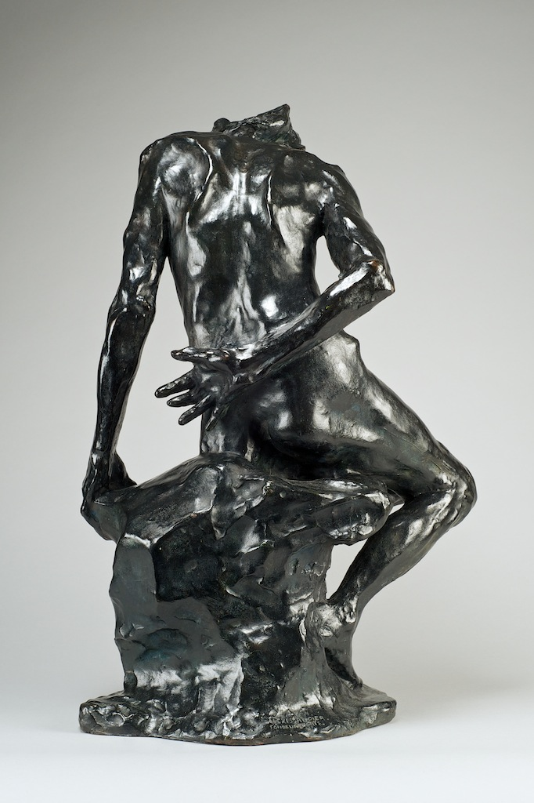
Rodin wanted to make a complete departure from such idealisation and be honest and blatant with his work.
By casting in bronze, he exposes all the years of ageing (wrinkles, skin bags etc.) in a intense, accurate amount of detail and stays true to the likeness of his sitter.
The unidealised nature of this work is a complete contrast from the previous standards of the female nude; a woman must be curvaceous, softly carved, submissive, coy and the quintessential example of femininity.
His depiction isn’t for the male gaze. But instead a challenge to ideas of beauty and aesthetics and to reiterate that beauty is just a construct.
Rodin believed personality/character was the more important aspect about someone, over appearance.
So personality > looks

Slide 8
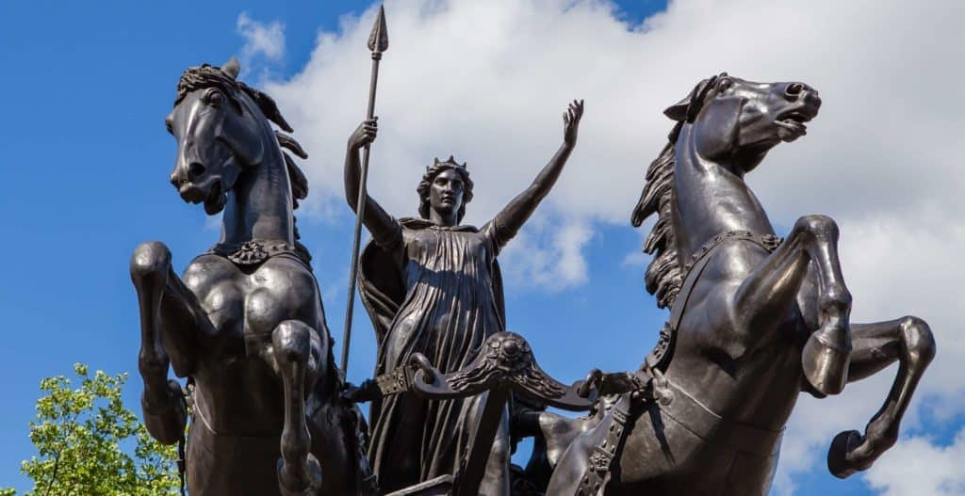
When showcased people deemed it as “an artistic crime” and “degenerate”
To them this work was extremely provocative and confrontational, but others that resonated with Rodin’s agenda deemed it as avant-garde.
Some of the greatest sculptors used bronze as a material for their work.
The use of bronze is associated with grandeur, importance and imperialism as famous rulers have been depicted in the metal.
For Rodin to showcase an ‘unattractive’ lower class woman in bronze, suggests he’s bringing importance to the subject and saying, it is just as worthy as a typical Venus sculpture.
This sculpture will be long-lasting because of the duration of its material, meaning it will stand timeless against other famous bronze sculptures, as will the message behind it.

